Slide 1
Data Dashboards
Graphs
Traffic lights
Characters

Slide 2
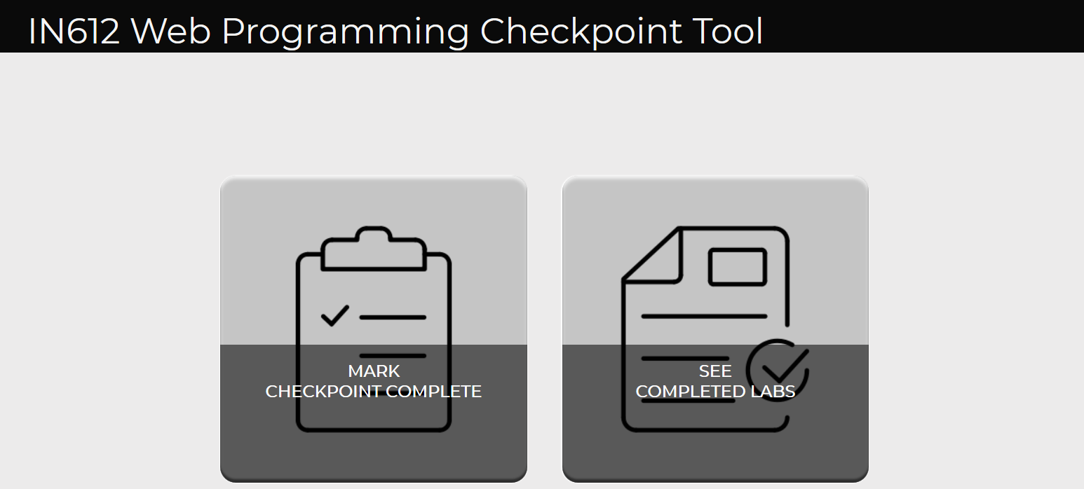
Starting point

Slide 3
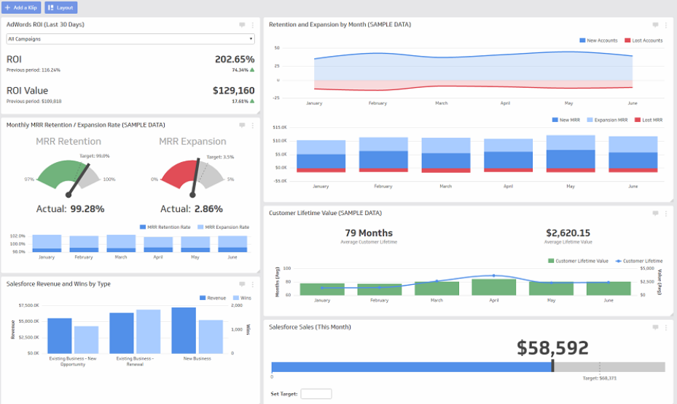

Slide 4
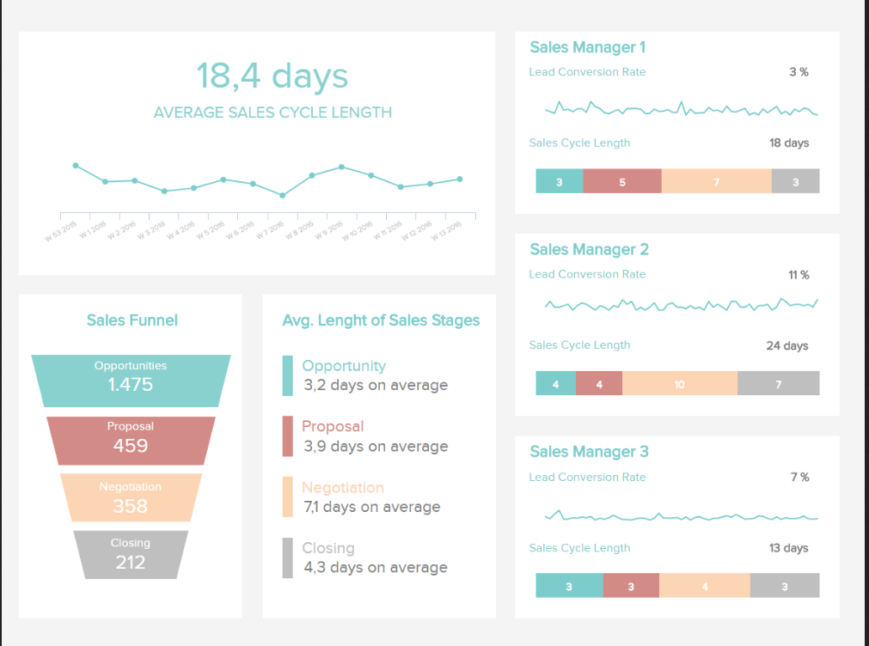

Slide 5
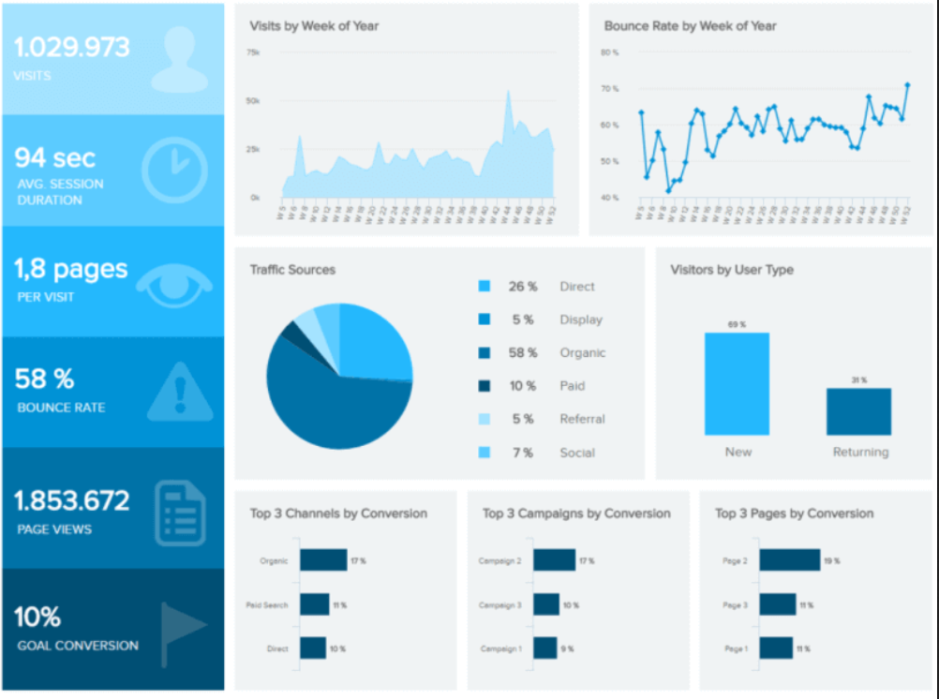

Slide 6
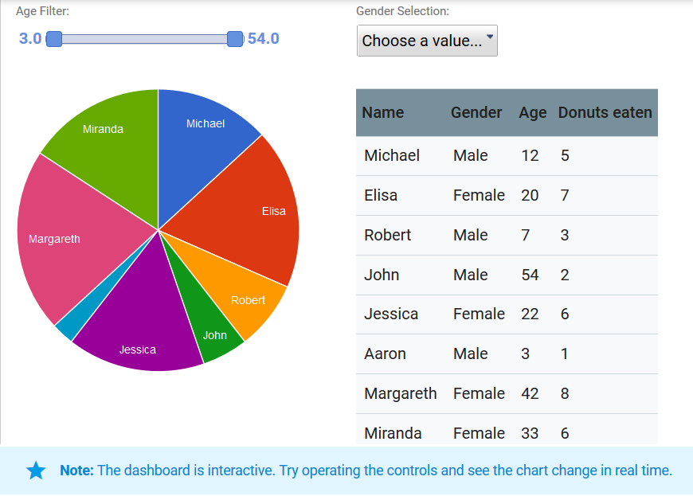

Slide 7


Slide 8


Slide 9


Slide 10


Slide 11
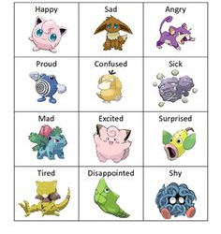

Slide 12
Ideas
Checkpoint 1 – 33 completions
Checkpoint 2 – 30 completions
Checkpoint 3 - 2 completions

